Slide 1
Instruction Set Architecture
Eric Oliver

Slide 2
Introduction
What is an ISA
Examples of ISA

Slide 3
What is an instruction set architecture
It is an abstract model of a computer
It allows for code to work on multiple implementations of the same ISA
An ISA defines everything a machine language programmer needs to know in order to program a computer

Slide 4
History
Starting in the 1936
More known start date of 1945
John von Neumann's First Draft of a Report on the EDVAC

Slide 5
Types of Architectures
complex instruction set computer (CISC)
reduced instruction set computer (RISC)
very long instruction word (VLIW)
long instruction word (LIW)
explicitly parallel instruction computing (EPIC)
minimal instruction set computer (MISC)
one instruction set computer (OISC)

Slide 6
Risc vs cisc
Risc
cisc
Focus on software
Registers to load and store are independent
More transistors for memory
Focus on hardware
Registers to load and store are incorporated into complex commands
More transistors to store complex commands

Slide 7
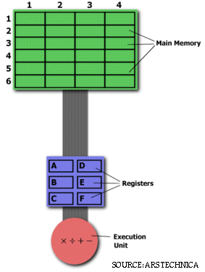
Example
Problem: multiply positions (2,5) by (5,3) and store the result back into 2,5
CISC Approach:
MULT (2,5),(5,3)
RISC Approach:
LOAD A,(2,5)
LOAD B,(5,3)
PROD A,B
STORE (2,5),A

Slide 8
Examples of CISC Today
Any CPU by Intel or AMD

Slide 9
Examples of RISC today
Arm Architecture
Raspberry Pi’s
Cell Phones
Nintendo Handheld consoles since the GameBoy Advanced
IBM’s Power Architecture
Found in the GameCube, XBox360, and the PS3

Slide 10
Questions
What are the two most common architectures?
What Major Company Uses Arm processors in its products

Slide 11
Works Cited
https://cs.stanford.edu/people/eroberts/courses/soco/projects/risc/risccisc/
http://archive.arstechnica.com/cpu/4q99/risc-cisc/rvc-5.html#Branch

